Slide 1
Understanding JavaScript Testing
qiaohua@taobao.com
2010-10-14

Slide 2
Why?
Cross-browser issues.
跨浏览器问题;
The possibility for causing an unforeseen problem is simply too great.
不可预见的问题的存在性很大;

Slide 3
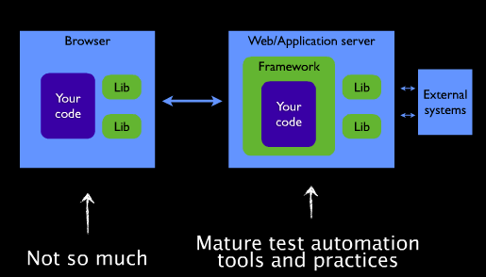
How?

Slide 4
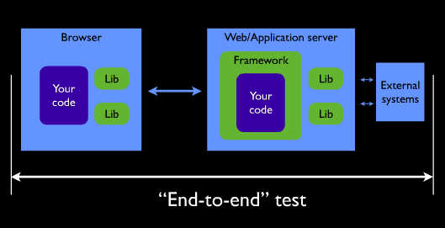

Slide 5
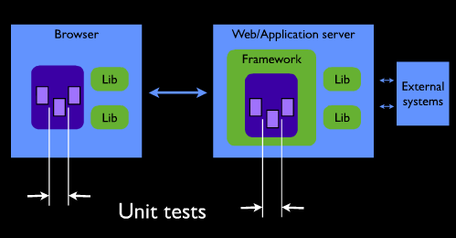

Slide 6
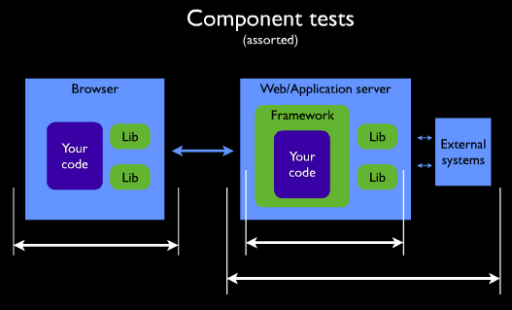

Slide 7
Test strategy
End-to-end test:
Big, Powerful, Convincing;
Slow, In-exact, High-maintenance;
Unit tests
Small, Quick, Focused, Resilient;
Limited;
Component tests

Slide 8
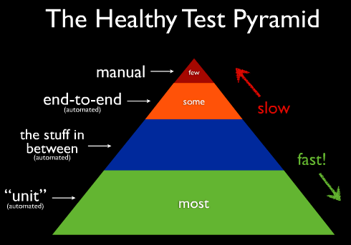
the balance between many fast test and a few slow tests;

Slide 9
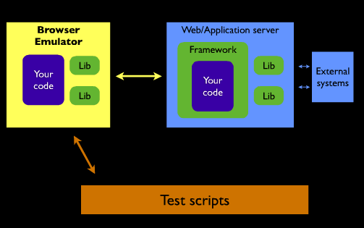
Test Methods
- 测试脚本 + 模拟环境;

Slide 10
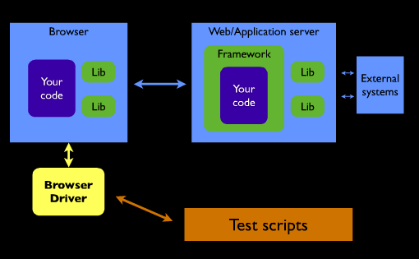
测试脚本 + 驱动真实浏览器;

Slide 11
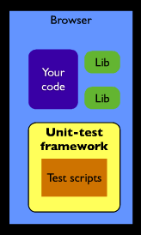
直接在浏览器中 Unit test;

Slide 12
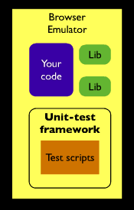
模拟环境下进行 Unit test;

Slide 13
Unit Testing
Break code into logical chucks for testing.
将整段代码分成多个逻辑块来测试;
Focus on one method at a time
同一时间内只关注一个方法;
- 支持UT的已有工具: QUnit, JSUnit, YUITest;
- Run now, run later;
- Run in new browsers;
- Put the test in a file rather than Firebug;

Slide 14
Unit Testing Framework
Assertion Function
Tests/Test Case
- test('A test.', function(){
asset(true, 'something');
asset(false, 'something');
});
- setUp()/tearDown()/setUpPage()
- Async Tests;
setTimeout(function(){}, 100);
Test Suite
- addTestPage()/addTestSuite();
Test Runner
- Responsible for loading an executing tests;
Trace/log
- warn()/inform()/debug() 3 tracing levels;

Slide 15
传统单元测试, 如 YUI3
Test Case
- 函数名组织：Classic + BDD;
- setUp / tearDown;
- should: ignore, error, fail;
Assertions
Mock Objects
Asynchronous Tests
- wait;
- resume;
Test Suites
Test Runner
Test Reporting

Slide 16
var testCase = new Y.Test.Case({
name: "TestCase Name",
testSpecialValues : function () {
Y.Assert.isFalse(false); //passes
Y.Assert.isTrue(true); //passes
Y.Assert.isNaN(NaN); //passes
Y.Assert.isNaN(5 / "5"); //passes
Y.Assert.isNotNaN(5); //passes
Y.Assert.isNull(null); //passes
Y.Assert.isNotNull(undefined); //passes
Y.Assert.isUndefined(undefined); //passes
Y.Assert.isNotUndefined(null); //passes
Y.Assert.isUndefined({}, "Value should be undefined."); //fails
}
});

Slide 17
Behavior Testing
Similar to unit testing, but broken up by task;
Functionally very similar to unit testing, uses different terminology;
支持BT的现有工具: Screw.Unit , JSSpec, Jasmine

Slide 18
如: Jasmine
code is specification;
describe 即是 TestCase, 也是 TestSuite;
ignore 更简单，加上 x 即可;
Matchers 可自定义，可覆盖，可添加;
- toThrow 比 YUI Test 更易用;
- expect 本身就是一句描述，无需注释;
Spies

Slide 19
describe('Calculator', function () {
var counter = 0
it('can add a number', function () {
counter = counter + 2; // counter was 0 before
expect(bar).toEqual(2);
});
it('can multiply a number', function () {
counter = counter * 5; // counter was 2 before
expect(bar).toEqual(10);
});
});
var testCase = new Y.Test.Case({
name: "TestCase Name",
testSpecialValues : function () {
Y.Assert.isFalse(false); //passes
Y.Assert.isTrue(true); //passes
Y.Assert.isNaN(NaN); //passes
Y.Assert.isNaN(5 / "5"); //passes
Y.Assert.isNotNaN(5); //passes
Y.Assert.isNull(null); //passes
Y.Assert.isNotNull(undefined); //passes
Y.Assert.isUndefined(undefined); //passes
Y.Assert.isNotUndefined(null); //passes
Y.Assert.isUndefined({}, "Value should be undefined."); //fails
}
});

Slide 20
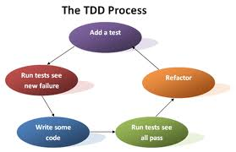
TDD vs BDD
TDD is not about testing, but rather about design and process;
TDD is a design activity;
Why TDD?
Makes you think about required behavior;
Reduces speculative code;
Provides documentation;
Improves quality;

Slide 21
BDD
BDD的重点是通过与利益相关者的讨论取得对预期的软件行为的清醒认识。
它通过用自然语言书写非程序员可读的测试用例扩展了测试驱动开发方法。
行为驱动开发人员使用混合了领域中统一的语言的母语语言来描述他们的代码的目的。
这让开发着得以把精力集中在代码应该怎么写，而不是技术细节上，
而且也最大程度的减少了将代码编写者的技术语言与商业客户、用户、利益相关者、项目管理者等的领域语言之间来回翻译的代价。

Slide 22
Jasmine 实战
Specs:
说明, 使用 it(description, fn) 来描述;
it('should increment a variable', function () { // 一段有意义的描述, 加一个要执行的系列动作
var foo = 0;
foo++;
});

Slide 23
Expecations:
期望, 存在于 spec 中, 用来描述你期望得到的结果, 使用 expect() + matchers;
it('should increment a variable', function () {
var foo = 0; // set up the world
foo++; // call your application code
expect(foo).toEqual(1); // passes because foo == 1
});

Slide 24
Suites
Specs 的集合, 等于 Test Case, 使用 describe() 函数;
describe('Calculator', function () {
it('can add a number', function () {
...
});
it('has multiply some numbers', function () {
...
});
});
Suites 的名字一般为你要测试的模块/组件/应用名字;
Suites 中的每个 Spec 只执行一次, 一个 Suites, 一个作用域, 里面的 Spec 共享;

Slide 25
Nested Describes
支持嵌套的 Describes;
beforeEach(fn)/afterEach(fn) --- 对应于以前的 setUp(fn)/tearDown(fn) , 在每个 spec 执行之前/之后 执行;
this.after(fn) 在特定的某个 spec 执行之后执行. 没有 this.before !
describe('some suite', function () {
it(function () {
var originalTitle = window.title;
this.after(function() { window.title = originalTitle; });
MyWindow.setTitle("new value");
expect(window.title).toEqual("new value");
});
});
xit()/xdescribe() 设置 spec/describe 不可用.

Slide 26
Matchers
expect(x).toEqual(y); compares objects or primitives x and y and passes if they are equivalent
expect(x).toBe(y); compares objects or primitives x and y and passes if they are the same object
expect(x).toMatch(pattern); compares x to string or regular expression pattern and passes if they match
expect(x).toBeDefined(); passes if x is not undefined
expect(x).toBeNull(); passes if x is null
expect(x).toBeTruthy(); passes if x evaluates to true
expect(x).toBeFalsy(); passes if x evaluates to false
expect(x).toContain(y); passes if array or string x contains y
expect(x).toBeLessThan(y); passes if x is less than y
expect(x).toBeGreaterThan(y); passes if x is greater than y
expect(fn).toThrow(e); passes if function fn throws exception e when executed
expect(x).not.toEqual(y); compares objects or primitives x and y and passes if they are not equivalent

Slide 27
Matcher 是可以自定义的. 使用 addMatchers(obj)
toBeLessThan: function(expected) {
return this.actual < expected;
};
beforeEach(function() {
this.addMatchers({
toBeVisible: function() { return this.actual.isVisible(); }
});
});

Slide 28
Spies
permit many spying, mocking, and faking behaviors.
用于模拟传参, 回调函数, 异步请求/行为监测
it('should spy on an instance method of a Klass', function() {
var obj = new Klass();
spyOn(obj, 'method');
obj.method('foo argument');
expect(obj.method).toHaveBeenCalledWith('foo argument');
var obj2 = new Klass();
spyOn(obj2, 'method');
expect(obj2.method).not.toHaveBeenCalled();
});

Slide 29
Asynchronous Specs
异步测试, 测试 ajax api, 事件回调等, 就是针对在未来某个点上会发生的行为.
runs() 阻塞执行, 就像是直接调用一样; 多个runs() 共享作用域.
waits(timeout) 等待多长时间后再执行下面的语句.
waitsFor(function, optional message, optional timeout) 直到 function 返回 true 才执行下去.
describe('Spreadsheet', function() {
it('should calculate the total asynchronously', function () {
var spreadsheet = new Spreadsheet();
spreadsheet.fillWith(lotsOfFixureDataValues());
spreadsheet.asynchronouslyCalculateTotal();
waitsFor(function() {
return spreadsheet.calculationIsComplete();
}, "Spreadsheet calculation never completed", 10000);
runs(function () {
expect(spreadsheet.total).toEqual(123456);
});
});
});

Slide 30
http://kissyteam.github.com/kissy/tests/index.html

Slide 31
其他相关
Automation
- Functional Testing
- Selenium IDE:
- records and automates actions performed by a user;
- An extension for Firefox that records the actions;
- Can play them back in all browsers(limited by cross-domain issues);
- Primarily for testing web applications, everyone should use it;
- Browser launching
- WebDriver;
- Waitr;
- JsTestDriver;
- Selenium RC;

Slide 32
- Server-Side
- Ignore the browser! Simulate it on the server-side;
- Almost always uses Java + Rhino to construct a browser;
- Some frameworks
- Crosscheck: Pure Java, even simulates browser bugs;
- Env.js: Pure JavaScript, focuses on standards support;
- Blueridge: Env.js + Screw.Unit + Rhino;
- Distributed
- Selenium Grid
- Push Selenium tests out to many machines(that you manage), simultaneously;
- Collect and store the results;
- TestSwarm
- Push tests to a distributed swarm of clients;
- results viewable on the server;
- testswarm.com;

Slide 33
The Scaling Problem
- All need to be run for every commit, patch, and plugin;
- JavaScript testing doesn't scale well;
Distributed Testing
- Hub server;
- Clients connect and help run test;
- A simple Javascript client that can be run in all browsers, including mobile browsers;
- TestSwarm;

Slide 34
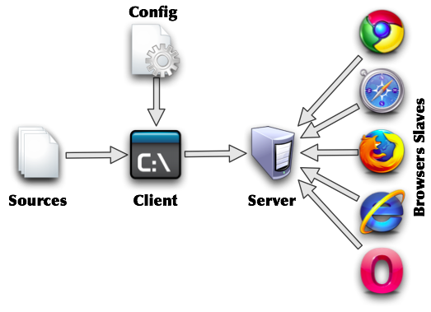
JSTestDriver
服务端/客户端,
test runner 捕获浏览器, 通过命令通知服务器进行测试. 然后每个被捕获的浏览器运行 tests, 并将结果返回;

Slide 35
优点:
- 运行测试不需要手工跟浏览器进行交互;
- 可在多台机器上运行, 包括移动设备, 允许任意复杂的测试;
- 测试非常快速, 因为不需要操作DOM, 且多个浏览器中是同时进行;
- 现已支持异步请求测试;
缺点:
- JavaScript required to run tests is slightly more advanced, and may cause a problem in old browsers;

Slide 36
使用JSTestDriver
目录结构:
JSTestDriver
- jsTestDriver.conf # 配置文件
- JsTestDriver-1.2.2.jar # 核心程序, 包含客户端/服务器
- src/ # 待测试 js 源码
- src-test/ # js 测试脚本
配置:
server: http://localhost:9876
load:
- src/*.js
- src-test/*.js

Slide 37
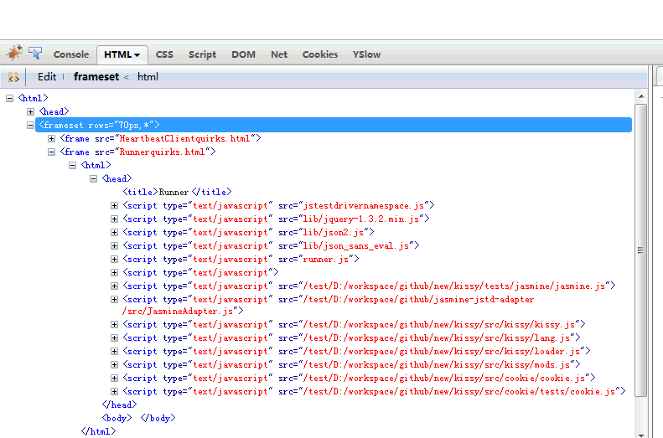
服务器: java -jar JsTestDriver-1.2.2.jar --port 9876
浏览器捕获: http://localhost:9876/capture
运行测试: java -jar JsTestDriver-1.2.2.jar --tests all
D:\workspace\Test>java -jar JsTestDriver-1.2.2.jar --tests all --verbose
[PASSED] cookie get.test that it should return the cookie value for the given na
me
[PASSED] cookie get.test that it should return undefined for non-existing name
[PASSED] cookie set.test that it should set a cookie with a given name and value
[PASSED] cookie remove.test that it should remove a cookie from the machine
[PASSED] json stringify.test that it should convert an arbitrary value to a JSON
string representation
[PASSED] json parse.test that it should parse a JSON string to the native JavaSc
ript representation
Total 6 tests (Passed: 6; Fails: 0; Errors: 0) (0.00 ms)
Firefox 3.6.10 Windows: Run 6 tests (Passed: 6; Fails: 0; Errors 0) (0.00 ms)

Slide 38
结合 jasmine
更改配置为:
server: http://localhost:9876
load:
- ../github/new/kissy/tests/jasmine/jasmine.js <-----
- ../github/jasmine-jstd-adapter/src/JasmineAdapter.js <-----
- ../github/new/kissy/src/kissy/*.js
- ../github/new/kissy/src/cookie/cookie.js
- ../github/new/kissy/src/cookie/tests/cookie.js

Slide 39
IDE 中使用
IDEA 安装 JSTestDriver plugin, 重启 IDEA , 就可以看到
jstestdriver.gif
cmd下, java -jar JsTestDriver-1.2.2.jar --tests all

Slide 40
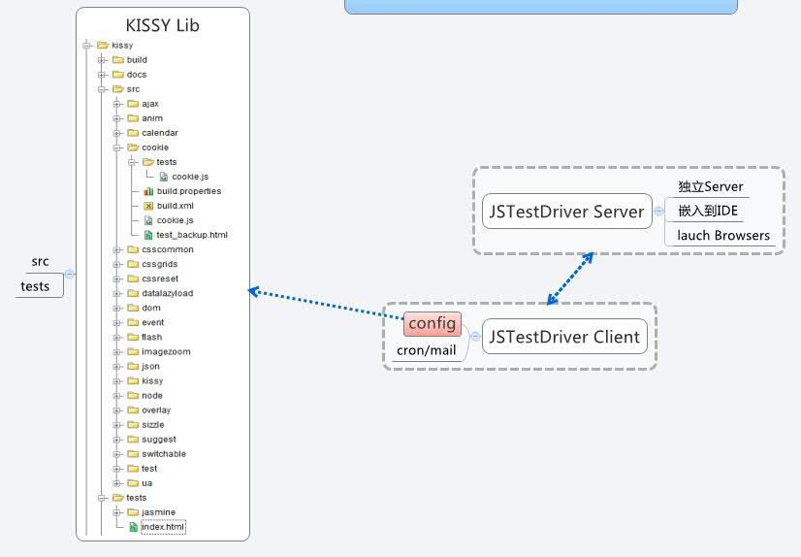
小结一下

Slide 41
TestSwarm 众包测试
TestSwarm provides distributed continuous integration testing for JavaScript.
why? -- JavaScript Testing Does Not Scale
The primary goal of TestSwarm is to take the complicated, and time-consuming, process of running JavaScript test suites in multiple browsers and to grossly simplify it. It achieves this goal by providing all the tools necessary for creating a continuous integration workflow for your JavaScript project.

Slide 42
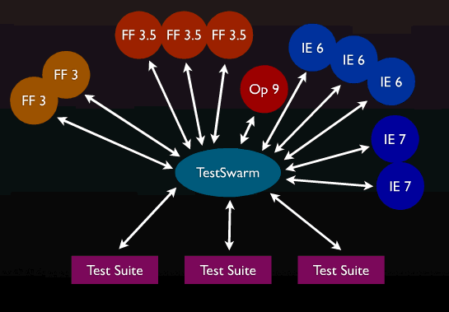
中心服务器, 客户端连接至他, job 提交到这里;
客户端是一个 test runner 实例, 加载在浏览器中.
test runner 每30秒中请求服务器是否有新的 test suites 需要运行, 如果有, 就执行(放在一个iframe中), 其结果发送到服务器上. 没有就睡眠等待;
一个 job 包含 test suites 和 browsers(需要在哪些浏览器中进行测试), 运行至少一次.

Slide 43
私有成员测试
Approach 1: Don't Test Private Methods
- 如果你需要对私有成员做测试时, 那就应该要考虑是否将它转成公有方法;
- 间接测试, 测试那些调用该私有成员的公有方法;
Approach 2: Give the methods package access.
- 给私有方法套层 package;
- but it does come with a slight cost.
Approach 3: Use a nested test class.
- to nest a static test class inside the production class being tested.
- how?
Approach 4: Use reflection.
- it provides a clean separation of test code and production code.

Slide 44
UI 测试
DOM
事件模拟
目前提供 Web UI 测试的工具: record -> play
Selenium
Selenium is a robust set of tools that supports rapid development of test automation for web-based applications.
Selenium provides a rich set of testing functions specifically geared to the needs of testing of a web application.
Watir
It allows you to write tests that are easy to read and maintain. It is simple and flexible.
Watir drives browsers the same way people do. It clicks links, fills in forms, presses buttons. Watir also checks results, such as whether expected text appears on the page.
SIKULI

Slide 45
展望
全自动化
WebUI Test Studio 功能强大的集成开发环境
Testcase Management, Execution, and Source Control;
Integration with Visual Studio Unit Testing;
Powerful Automated Test Recorder;
DOM Explorer;
Point-and-click Test Recording Surface;
自动报告的生成
众包测试
全网测试

Slide 46

Thanks for your attention!

